Slide 1
This work is licensed under the Creative Commons Attribution 4.0 International License. To view a copy of this license, visit http://creativecommons.org/licenses/by/4.0/ or send a letter to Creative Commons, PO Box 1866, Mountain View, CA 94042, USA.
Copyright (c) 2022 Cisco Systems, Inc. and its affiliates
All rights reserved.

Slide 2





[Insert survey QR code survey URL]
OR
[Survey URL]
What do you do for yourself in order to keep healthy body and healthy mind?

Slide 3

Session 1: Your Physical Layer: Healthy Body, Healthy Mind
Full Stack Wellness & Inclusion Series

Slide 4





Agenda
Intro
How does it connect with a bigger picture?
Our DevRel Story
How our team members keep healthy body and healthy mind?
Start change NOW
How <your organization> supports our wellbeing?
Let’s talk!
Tell us about your routines and how you started them, or why you do not have them and what makes it difficult to start.
DevRel Healthy Body, Healthy Mind challenge
More information about our steps challenge!

Slide 5
Our Full Stack Wellness & Inclusion Series
CI/CD pipeline for your best self I am in an environment where I can thrive, be creative, and express myself authentically. I want to help others do the same.
Self- Actualization Needs
Personal Code Reviews: Owning and Honoring our Achievements
I am in a team where I can support others, and I feel comfortable asking for support when I need it.
Esteem Needs
Developing a team where everyone belongs I am in an environment where I can express who I am and how I feel.
Love/Belonging Needs
Designing a team where everyone feels safe I am not scared to be myself in my workplace. I feel safe here.
Safety Needs
Your Physical Layer: Healthy Body – Healthy Mind: We can't take care of others if we don't take care of ourselves
Physiological Needs

Slide 6
Our Story
How our team members keep healthy body and healthy mind?

Slide 7

You At Your Best
Our definition of
PHYSICAL Wellbeing
EMOTIONAL Wellbeing
SOCIAL Wellbeing
FINANCIAL Wellbeing
The Whole You

Slide 8

Wellbeing
TIPS
Keep your goals small
Set your boundaries and share them
Write 3 things you are grateful for each day
Be kind to yourself and to others

Slide 9
wellbeing offerings
[List your company’s Wellbeing offerings here]

Slide 10




Wellbeing is
one click away
Insert [Well-being/ Benefits URL]
[Insert Image Here]

Slide 11
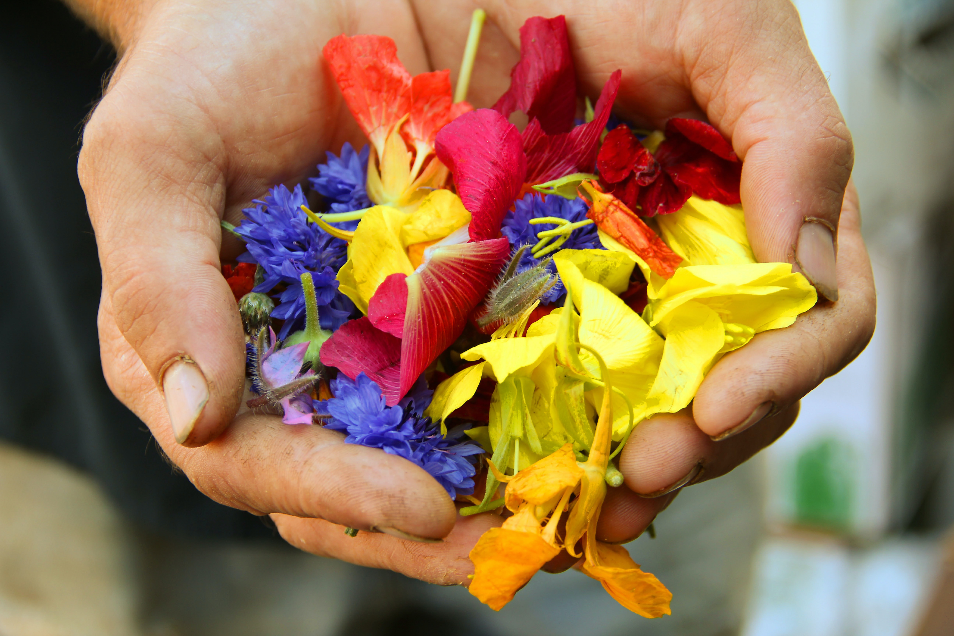
One small choice can cause a smile…
or change a life
Notes:
Photo by Jan Canty on Unsplash

Slide 12
[Insert survey QR code survey URL]
OR
[Survey URL]
What kind of a small change will you make as the result of this session?

Slide 13

Healthy Body, Healthy Mind Challenge
[Insert Team Activity example:
Be Active Challenge]

Slide 14
Calls to Action:
Start changing your routine now – small steps matter
Tell us how we can support you
Learn more about <your organization> health & wellbeing initiatives
Visit our D&I site for all the latest updates

Slide 15

Creating a team where everyone thrives
Bi-Weekly Stand Up:
Check-in Activity
<date>
Bi-Weekly Stand Up:
Check-in Activity
<date>
Bi-Weekly Stand Up:
Check-in Activity
<date>
Bi-Weekly Stand Up:
Check-in Activity
<date>
TBC…
Session 1: Your Physical Layer: Healthy Body, Healthy Mind
Session 2: Designing a Team Where Everyone Feels Safe
Session 3: Developing a Team Where Everyone Belongs
Session 4: Team Code Reviews: The Art of Giving and Receiving Support
Session 5: CI/CD Pipeline for Your Best Self
Kick Off Session: Full Stack Wellness & Inclusion
Today
Today + 1 month
Today + 2 months
Today + 3 months
Today + 4 months

Slide 16
DO NOT USE
[Q& A with executive sponsor ]
Notes:
Question 1: What do you see are the personal benefits of having a strong mind-body connection?
Question 2: What are some of the activities you do to care for your physical health? How do they support a healthy mind-body connection?
Question 3: Can you walk us through your daily routine to keep your mental and physical health in top share?
Question 4: The pandemic changed so much of how we lived -- it placed new demands on mental health and also changed how we are active? How did you accommodate to keep your physical and mental health a priority?
Question 5: What recommendations would you share with the team?
Question 6: Any closing thoughts on this session or the series we are embarking on? (Just your final thoughts)

